Slide 1

IDS for Campus Network: Standup 2
ICT30016 Technology Innovation Project
Jane Yan Zhen YU · Yan Han Wong · Bruce Gee Yick WONG · Neville Zi Yang
Notes:
Jane:
Hi everyone.
The purpose of this standup is to update on our progress in Weeks 7 and 8 of the Campus IDS project.
We will cover our progress, current tasks, findings and blockers, then go through the next steps for this week.

Slide 2







Progress: Design 1 Complete
Detection layers
Concept report
Rule + Stats + Isolation Forest
Design 1 and Design 2 submitted
Design 1
Alert filtering
Random Forest layer
Rule, Stats and ML layers working
Dashboard with charts and Settings
Tested with Kali attacks in our lab
Filter by layer, CSV export
Design 2: added as a fourth layer
Dashboard
Lab testing
Charts, Settings, attack box
Kali VM attacks, all layers
Notes:
Progress (Yan Han):
First, Design 1 is now complete.
It has three detection layers: Suricata rules, a statistical layer for port scans and floods, and the Isolation Forest.
The dashboard shows the alerts live, with charts, a Settings panel, a filter by layer, CSV export, and a box with the attack commands for our Kali VM.
We also started Design 2. It keeps these three layers and adds a Random Forest as a fourth layer.
The concept report is submitted, and we have tested all layers with attacks from the Kali VM in our lab.

Slide 3




Design 1: Detection Layers
Rule layer (Suricata)
Alerts on a ping and when a source sends 20 SYN packets within 5 seconds.
Stats layer
Port scan: 15 ports in 10 s. Flood: 150 connections in 10 s
ML layer (Isolation Forest)
Trained on normal traffic and flags flows with unusual volume and size.
Live dashboard
All alerts go to the Flask dashboard live through WebSocket.
Notes:
Design 1 Layers (Yan Han):
So more details，
Design 1 has three layers.
The first is the rule layer. Suricata has two custom rules: one alerts on a ping, and one alerts when a source sends 20 SYN packets within 5 seconds.
The second is the statistical layer. It counts per source address, and raises an alert for a port scan when one source touches 15 different ports in 10 seconds, or for a flood at 150 connections in 10 seconds.
The third is the Isolation Forest. It is trained on normal traffic and flags flows with unusual volume and size.
All alerts go to the Flask dashboard live through WebSocket.

Slide 4
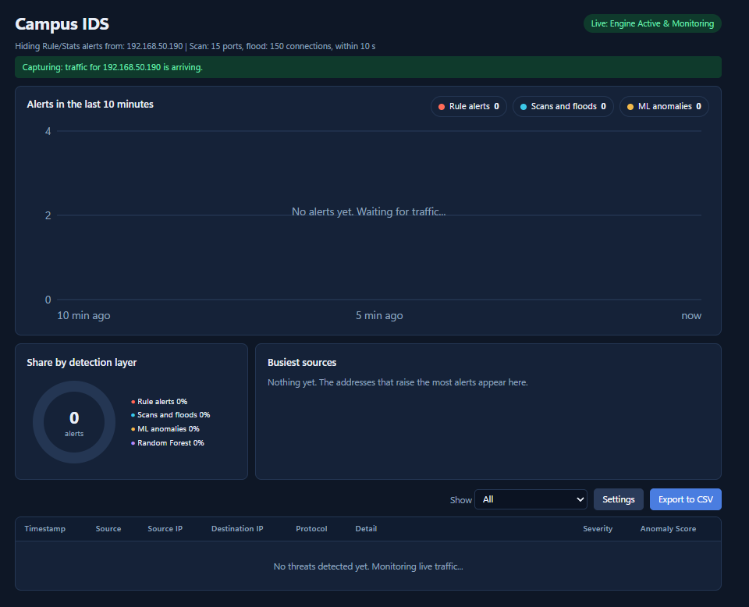
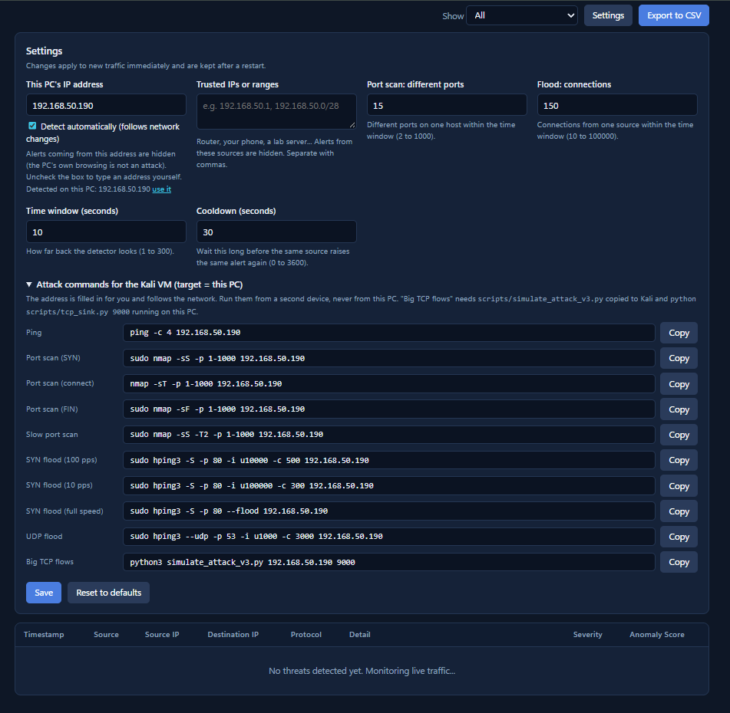
Design 1: Dashboard and Settings
Dashboard: live alerts, charts, filter and CSV export
Settings: thresholds, trusted IPs and attack commands
Notes:
Design 1 Details (Yan Han):
This is our dashboard for Design 1.
It shows the alerts of the last 10 minutes in a chart, a pie chart of each detection layer, and the busiest source addresses.
The table below lists every alert, and we can filter it or export it to CSV.
This is the Settings panel.
The PC's own address is detected automatically and hidden, because its own browsing is not an attack.
We can add trusted addresses,
change the port scan and flood thresholds and the time window,
and there is a box with the attack commands we run from the Kali VM.

Slide 5



Current Tasks This Week
Live Attack Tests
Design Comparison
Final Dashboard
Run Kali attacks against all four layers
Compare Design 1 and 2 on the same data
Four-layer alerts, filters and CSV export
Target: Week 9
Ongoing
Target: Week 10
Notes:
Current Tasks (Yan Han):
This week we are working on three tasks.
We are running live attack tests from the Kali VM against all four layers, with a target of Week 9.
We are comparing Design 1 and Design 2 on the same data.
We are finishing the dashboard, with alerts from all four layers, filters and CSV export, with a target of Week 10.

Slide 6
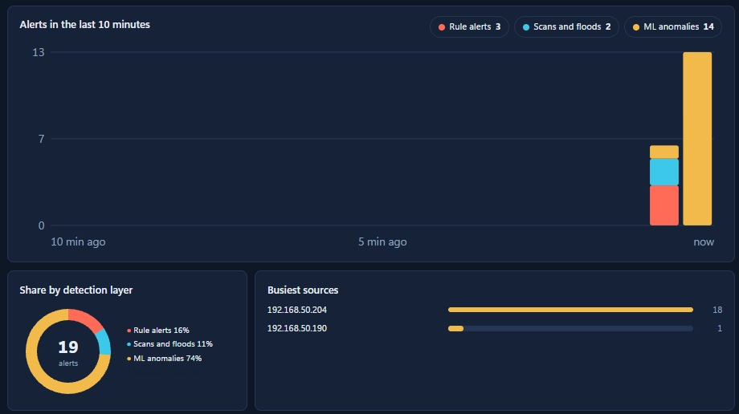
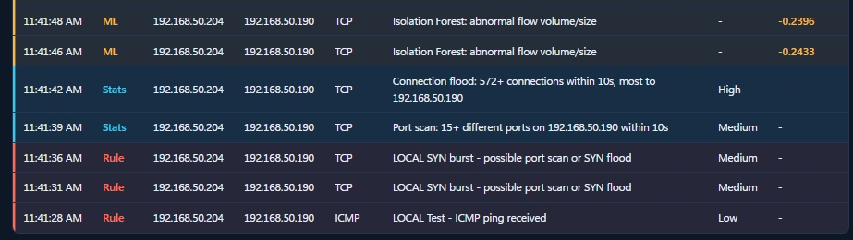
Design 1 Results
Rule
Ping and SYN burst alerts
Stats
Port scan and connection flood
ML (Isolation Forest)
Big TCP flows
Notes:
Demo (Yan Han):
This is Design 1 after we ran the attacks from the Kali VM.
The chart shows all three layers at once.
The red alerts are the rules, for the ping and the SYN burst.
The blue alerts are the statistical layer, for the port scan and the connection flood.
The yellow alerts are the Isolation Forest, which caught the big-flow attack.

Slide 7
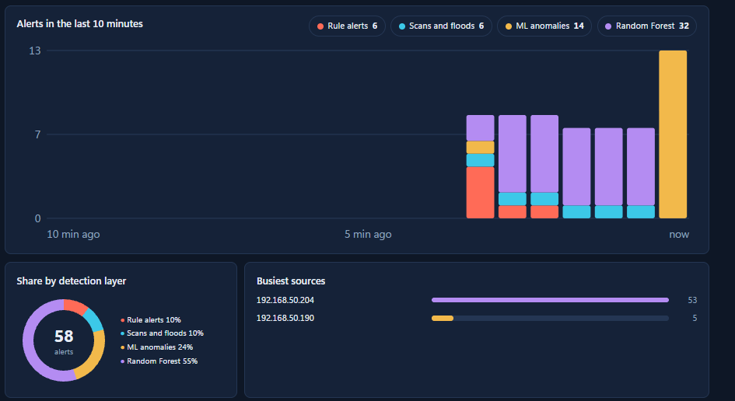
Design 2: Adding a Random Forest Layer
Design 1: Rule + Stats + ML
Design 2: adds Random Forest (purple)
Three layers, as in the earlier run.
It also looks at one source IP over 10 seconds.
Notes:
Design 2 (Yan Han):
Design 2 keeps all three layers of Design 1 and adds a fourth layer, a Random Forest.
On the dashboard, the Random Forest alerts are purple, next to the red, blue and yellow alerts.
The Random Forest looks at all the flows of one source address in a 10 second window, using five features: number of connections, number of different ports, share of reset connections, average packets, and total bytes.
We train it using examples: windows of traffic that we marked as “attack” when we were attacking from Kali, and “normal” the rest of the time.
The statistical layer already catches scans and floods, but the statistical layer uses fixed limits that we chose ourselves, so it can miss attacks just below the limit.
We added a Random Forest that learns what an attack looks like. Together, the two layers found 95 of 96 attack windows.

Slide 8

Current Findings
Isolation Forest misses scans
0% on the CIC-IDS2017 scan and DDoS files
Stats layer catches fast attacks
Found 90 of 96 attack windows
Random Forest finds slower attacks
Found 86 of 96, with 1 false alarm
Layers cover each other
Stats and Random Forest found 95 of 96
Big flows need Isolation Forest
The Random Forest does not catch them
Notes:
Current Findings (Bruce):
We have five findings.
First, the Isolation Forest finds none of the scan and DDoS flows in the CIC-IDS2017 test files.
Second, our statistical layer catches fast scans and floods, 90 of 96 attack windows in our lab data.
Third, the Random Forest finds 86 of the 96 with one false alarm, and it does better on slower attacks.
Fourth, the statistical layer and the Random Forest miss different attacks, so together they found 95 of 96.
Lastly, the big-flow attack is only caught by the Isolation Forest, so we keep all four layers running together.

Slide 9


Blockers
Slow floods slip under our limit
PLAN
Test a lower flood limit and a longer time window
SYN flood at 10 packets per second: 0 of 3 windows found by Stats
ML alerts from our own PC
PLAN
Hide our own address in the ML layer too
Browsing on this PC raised ML alerts
Notes:
Blockers (Neville):
We have two blockers.
First, slow floods slip under our limit. A SYN flood at 10 packets per second makes only about 100 connections in 10 seconds, and our flood limit is 150, so the statistical layer found 0 of 3 windows.
The Rule layer and the Random Forest did catch most of them, but we want the statistical layer to see them too.
Our plan is to test a lower flood limit and a longer time window, and watch that the false alarms stay low.
Second, the ML layer still shows alerts from our own PC when we browse, because the own-address filter only covers the Rule and Stats layers.
Our plan is to hide our own address in the ML layer too.

Slide 10

Issue Resolution & Next Steps
1
2
3
Test slow floods
Compare designs
Hide own PC in ML
Lower flood limit, longer window
Same windows, same metrics
Same filter as Rule and Stats
THIS WEEK'S PRIORITIES
Final dashboard
Design comparison
Notes:
Jane:
To solve these blockers, we will test a lower port limit and a longer time window for the slow scans.
Then we compare Design 1 and Design 2 on the same windows with the same metrics.
After that we hide our own PC in the ML layer, the same way as in the Rule and Stats layers.
For this week, our priorities are the final dashboard and the design comparison.

Slide 11

Summary & Action Items
Design 1 is working and the Random Forest layer is added
Test slow scans with new limits
Compare Design 1 and Design 2
Hide our own PC in the ML layer
Finish the final dashboard
Thank you
Notes:
Closing (Jane):
To summarise, Design 1 is working and the Random Forest layer is added. Our action items are to test slow scans with new limits, compare Design 1 and Design 2, hide our own PC in the ML layer, and finish the final dashboard. Thank you.

